Slide 1
UNIT 2
Classical Cryptography

Slide 2
Content…
Introduction
Encryption Method
1. Symmetric/private(secret) key/one key/same key
2. Asymmetric/public key/ key pair/different key
Cryptography
1.Operation Used:- Substitution & Transposition
2.Key:-
3.Type of processing:- Algorithm types are block & stream
4. No. of Rounds
Substitution
Transposition
Product
Cipher

Slide 3
Terminology
Code
Replacement based on words or semantic structures
Cipher
Replacement based on symbol
Cryptosystem
A model used for encryption & dencryption process

Slide 4
Terminology
Cryptography
The science of encrypting or hiding secrets.
Cryptanalysis
The art & science of decrypting messages or breaking codes and ciphers.
Cryptanalyst
The hacker/attacker/person who attempts to break.
Cryptology
The combination of the two.

Slide 5
Terminology
Plaintext – an unencrypted message
Cipher text – an encrypted message
Key – pattern of alphabets & numbers
Security: - a combination of
Authentication
Authorization
Access control

Slide 6
Three Era’s of Cryptology
Pre-World War II
Cryptography as a craft
Widely used, but few provable techniques
1940s-1970
Secret key encryption introduced
Information theory used to characterize security
1970-present
Public key systems introduced

Slide 7
Substitution Ciphers
Plain text are replaced by other character, number, symbols according to a key.
Substitution is said to add confusion
Measure of the relationship between plaintext and cipher text

Slide 8
SUBSTITUTION TECHNIQUES
Caesar Cipher
Modified Version of Caesar Cipher
Mono-alphabetic Cipher
Homophonic Substitution Cipher
Polygram Substitution Cipher
Polyalphabetic Substitution Cipher
Playfair Square
Hill

Slide 9
Early cryptography
Caesar cipher
Julius Caesar in 100 B.C
Replace each letter l with (l +3) mod 26
“Attack at dawn” becomes
Dwwdfn dw gdzq
Two components:
Algorithm: Shift characters by a fixed amount
Key: the fixed amount.
Uniform Scheme of substitution
Plain text
Cipher Text

Slide 10
Caesar Cipher
The Caesar cipher is still useful as a way to prevent people from unintentionally reading something.
Fundamental problem: key length is shorter than the message.
Weak Scheme:- work backwards/reverse to break this.
Note: Knowing the algorithm (but not the key) makes this cipher much easier to crack
26 possibilities v/s 26!

Slide 11
Modified Version of Caesar Cipher
It cab be k place down the line this can increase complexity.
Once replacement scheme is decided, it would be constant for whole PT.
25 possibilities of replacement.
Brute force attack
Measure Weakness Predictability
Refer table on next slide

Slide 12
Weaknesses of the Caesar Cipher
Word structure is preserved.
Break message into equal-length blocks.
dww dfn dwg dzq
Solution: use multiple keys
E.g. shift by (3,5,7)
“Attack at dawn” becomes dya dhr dyk dbu
Better, but frequency information still present.
An attacker that knows the block size can separate out characters encoded with different keys.

Slide 13
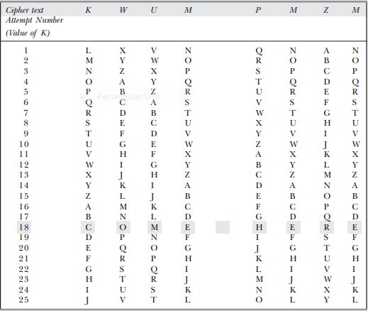
Attempt to Break Modified Caesar Cipher Text Using All Possibilities

Slide 14
Mono-alphabetic Cipher
RondomScheme of substitution
No relation between the replacement of one to other.
High number of possible permutation & combination.
Mathematically (26*25*24*23*………………..2) or 4*10^26
If the cipher text created with this technique is short
Letter frequency is a big clue
e,t,a,o most common English letters.
Using a single key preserves frequency.
Change

Slide 15
There is only one hitch. If the cipher text created with this technique is short, the cryptanalyst can try different attacks based on her knowledge of the English language.
As we know, some alphabets in the English language occur more frequently than others.
Language analysts have found that given a single alphabet in cipher text, the probability
that it is a P is 13.33%—the highest.
After P comes Z, which is likely to occur 11.67%.
The probability that the alphabet is C, K, L, N or R is almost 0—the lowest.
A cryptanalyst looks for patterns of alphabets in a cipher text, substitutes the various
available alphabets in place of cipher text alphabets, and then tries her attacks.
Apart from single-alphabet replacements, the cryptanalyst also looks for repeated patterns of words to try the attacks. For example, the cryptanalyst might look for two-alphabet cipher text patterns since the word to occurs very frequently in English.
If the cryptanalyst finds that two alphabet combinations are found frequently in a cipher text message, she might try and replace all of them with to, and then try and deduce the remaining alphabets/words.
Next, the cryptanalyst might try to find repeating three-alphabet patterns and try and replace them with the word the, and so on.

Slide 16
Homophonic substitution cipher
To escape frequency analysis, we can use a homophonic substitution cipher
Map symbols to multiple symbols.
e.g 0 -> {01, 10}, 1->{00,11}
Given Text 011010010 becomes: 011100101101011110
Advantage: -Frequencies Hidden
Disadvantage: -Message and Key are Longer

Slide 17
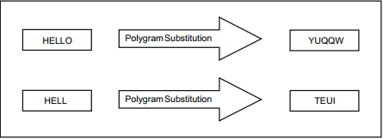
Polygram Cipher
All previous techniques are based on stream cipher.
Polygram is a block cipher.
Following figure shows it

Slide 18
Poly-alphabetic Cipher
Leon Battista invented in 1568.
This cipher has been broken many times, and yet it has been used extensively.
The Vigenere Cipher and the Beaufort Cipher are examples of it.
It uses multiple one-character keys.
Each of the keys encrypts one plain text character.
The first key encrypts the first plain text character; the second key encrypts the second plain text character, and so on.
After all the keys are used, they are recycled.
Thus, if we have 26 one-letter keys, every 26th character in the plain text would be replaced with the same key.
This number (in this case, 26) is called as the period of the cipher.

Slide 19
Example of Poly-alphabetic Cipher
For key v & PT i , the corresponding CT is at the intersection of row titled v & column titled i.
For encryption
1. Key=PT
2. Key repeats itself after n period.

Slide 20
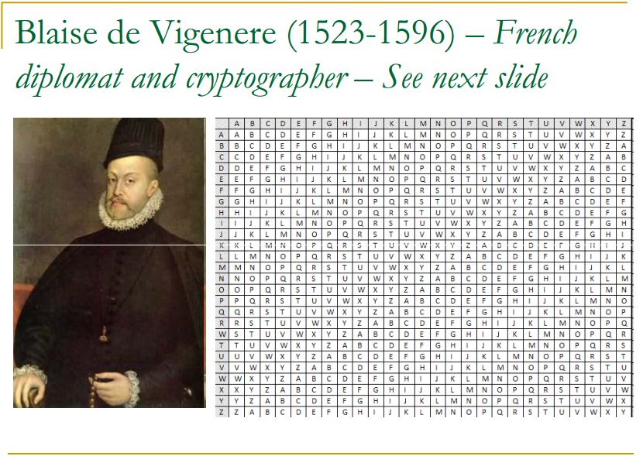

Slide 21
Play Fair Square
Used for Manual Encryption Of Data
Invented by Charles Wheatstone in 1854
But known by Lord Playfair, who was friend of CW
Playfair made this scheme popular & hence his name was used.
Used by British Army in World War I
Australians in World War II

Slide 22
Use
Fast
No equipments used.
Important but not critical information.
At the one could break it ->Value of information was nullified.
Crosswords that appears in several Newspapers.

Slide 23
Playfair Encryption Scheme
Uses to main processes
Playfair Cipher
Step 1:Creation & Population Of Matrix
Step2: Encryption Process

Slide 24
Step 1:Creation & Population Of Matrix
5*5 Matrix table
Used to store keyword & phrase that becomes Key for E,D.
Enter the keyword in the matrix row-wise: L->R
Top-to-bottom.
Drop duplicate letters.
Fill the remaining spaces in the matrix with the rest of the English alphabets(A-Z) that was not the part of our keyword.
Note:-While doing so, combine I & J in the same cell of the table. If I & J is the part of keyword, disregard both I & J while filling the remaining slots.

Slide 25
Step2: Encryption Process
PT broken into groups of two alphabets.
If both the alphabets are same OR only one is left, add an X after the first alphabet. E the new pair & continue.
If both the alphabets in the pair appear in the same row of our matrix, replace them with the alphabets of their immediate right respectively. If the original pair is on the right side of the row, then wrapping around to the left side of the row happens.
If both the alphabets in the pair appear in the same coloum of our matrix, replace them with the alphabets of their immediate below respectively. If the original pair is on the bottom side of the row, then wrapping around to the top side of the row happens.

Slide 26
Continue…
If the alphabets are not in same row or column of our matrix, replace them with the alphabets in the same row respectively , but the other pair of the corners of the rectangle defined by the original pair, The order is quite significant here. The first E alphabet of the pair is the one that is present on the same row as the first plain text alphabet.
D process works in the opposite direction. We also need to remove the extra X alphabets that we had added in step 1# above, if any.

Slide 27
Hill Cipher
Works on multiple letters at the same time(i.e: Polygraphic).
Lester Hill invented this in 1929.
Its roots in Matrix Theory of Mathematics.
Inverse of Matrix
Attack:- Known Plain Text Attack

Slide 28
Encryption Steps
Treat every letter in PT message as a number, so that A=0,B=1,…….,Z=25.
The PT matrix organized as a number.
PT is multiplied by a randomly chosen keys. The key matrix consist of size n*n, where n is the number of rows in PT.
Multiply the two matrix.
Now compute a mod26 value of the above matrix.
Now, translate the numbers to alphabets.

Slide 29
Decryption Steps
CT matrix multiply it by the Inverse of original key Matrix.
Take mod26 of the above matrix.
Now, translate the numbers to alphabets

Slide 30
Transposition Ciphers
A transposition cipher is one that permutes the symbols of the message according to a preset pattern.
Helps avoid detection of symbols based on correspondence.
Said to increase diffusion
Reduce redundancies in plaintext.

Slide 31

Rail Fence Technique
1. Write down the plain text message as a sequence of diagonals(i.e: zigzag sequence).
2. Read the text row-by-row, & write it sequentially.
Original plain text message: Come home tomorrow
we have the cipher text as: Cmhmtmrooeoeoorw
Simple too break

Slide 32
Simple Columnar Transposition Technique
It simply arranges the plain text as a sequence of rows of a rectangle that are read in columns randomly.
1. Write the plain text message row-by-row in a rectangle of a pre-defined size.
2. Read the message column-by-column. However, it need not be in the order of columns 1,2, 3 etc. It can be any random order such as 2, 3, 1, etc.
3. The message thus obtained is the cipher text message.
Trying out a few permutations and combinations of column orders quite simple to break into.

Slide 33

Original plain text message: Come home tomorrow
Let us consider a rectangle with six columns. Therefore, when we write the message in the rectangle row-by-row(suppressing spaces), it would look as follows
Now, let us decide the order of columns as some random order, say 4, 6, 1, 2, 5, 3. Then read the text in the order of these columns.
we have the cipher text as: eowoocmroerhmmto.

Slide 34
Simple columnar transposition technique with multiple rounds
To add more complexity & twist using no. of iterations.
Only one additional step is added is given below
Repeat step 1 to 3 as many times as desired.

Slide 35
Vernam Cipher
In 1920’s was first implemented at AT&T with the help of a device called as the Vernam Machine.
once an input cipher text for transposition is used, it is never used again for any other message (hence the name one-time pad).
Random set of non-repeating characters as the input cipher text key.
Same length as message
XORed with message
Theoretically unbreakable
Attacker can do no better than guessing
Ciphertext gives no information about plaintext.

Slide 36
Vernam Cipher Algorithm
1. Treat each plain text alphabet as a number in an increasing sequence, i.e. A = 0, B = 1, …Z = 25.
2. Do the same for each character of the input cipher text.
3. each number corresponding to the plain text alphabet to the corresponding input cipher text alphabet number.
4. If the sum thus produced is greater than 26, subtract 26 from it.
5. Translate each number of the sum back to the corresponding alphabet. This gives the output cipher text.

Slide 37
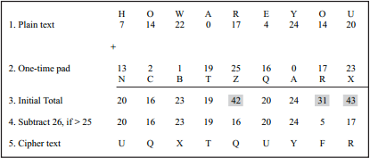
Example of Vernam Cipher

Slide 38
Book Cipher/Running Key Cipher
For producing cipher text, some portion of text from a book is used, which serves the purpose of a one-time pad.
Thus, the characters from a book are used as one-time pad, and they are added to the input plain text message similar to the way a one-time pad works.
It should be clear that since the one-time pad is discarded after a single use.
This technique is highly secure and suitable for small plain text message, but is clearly impractical for largemessages.

Slide 39
Product ciphers
By themselves, substitution and transposition ciphers are relatively insecure.
By combining these operations, we can produce a secure cipher.
This is how DES works.
M -> Sub(M) -> Trans(Sub(M)).
Might go through multiple rounds.

Slide 40
Symmetric Key Encryption
The Caesar Cipher and the one-time pad are examples of symmetric-key (secret-key) encryption.
Single key shared by all users.
Fast
How to distribute keys?

Slide 41
Keyspace
The keyspace is the set of all possible keys.
Caesar cipher: keyspace = {0,1,2,…,25}
Vernam cipher: |keyspace| = 2^{n} –1
Size of the keyspace helps us estimate security.
Assumption: exhaustive search is the only way to find a key.

Slide 42
Block Ciphers
The ciphers we have seen so far are known as block ciphers.
Plaintext is broken into blocks of size k.
Each block is encrypted separately.
Advantages: random access, potentially high security
Disadvantages: larger block size needed, patterns retained throughout messages.

Slide 43
Stream Ciphers
A stream cipher encodes a symbol based on both the key and the encoding of previous symbols.
C_{i} = M_{i} XOR K_{i} XOR M_{i-1}
Advantages:
can work on smaller block sizes – little memory/processing/buffering needed.
Disadvantages:
Random access difficult, hard to use large keys.
Sender and receiver must be synchronized
Inserted bits can lead to errors.

